Slide 1
Zillow: Digital Marketing Plan

Slide 2
Executive Summary
Research suggests that Zillow’s target home buyers/ home sellers and real estate agents are spending an increasing amount of time purchasing, selling, and conducting business online. The purpose of this plan is to show the benefit of implementing strategic digital advertising, social media, and web strategies to Zillow’s target audiences in the digital space.
These strategies and tactics position Zillow as the premier solution that allows home purchases and sellers to buy and sell homes with relative ease. We’ve also focused our efforts on building strategies and tactics that position the Zillow Premier Real Estate service as a program that enables real estate agents to develop and grow their business.
We expect that the implementation of these digital strategies will lead to an increase in traffic to the Zillow website and an increased subscription rate to the Zillow Premier Real Estate program leading to increased revenue.

Slide 3
Value Proposition
Zillow.com offers everything you need to buy, sell, rent, or remodel your home. They provide consumers with all the resources they need and connect them with the best local professionals who can help, all from the convenience of their own computer or mobile device.

Slide 4
Target Audience
The audience we are targeting with this digital plan is millennial+ adults - homeowners, renters, realtors, casual browsers, and those who want to list their home or home-related services.

Slide 5
Personas
Zillow Zack
Realtor Renee
Renter Rachel

Slide 6
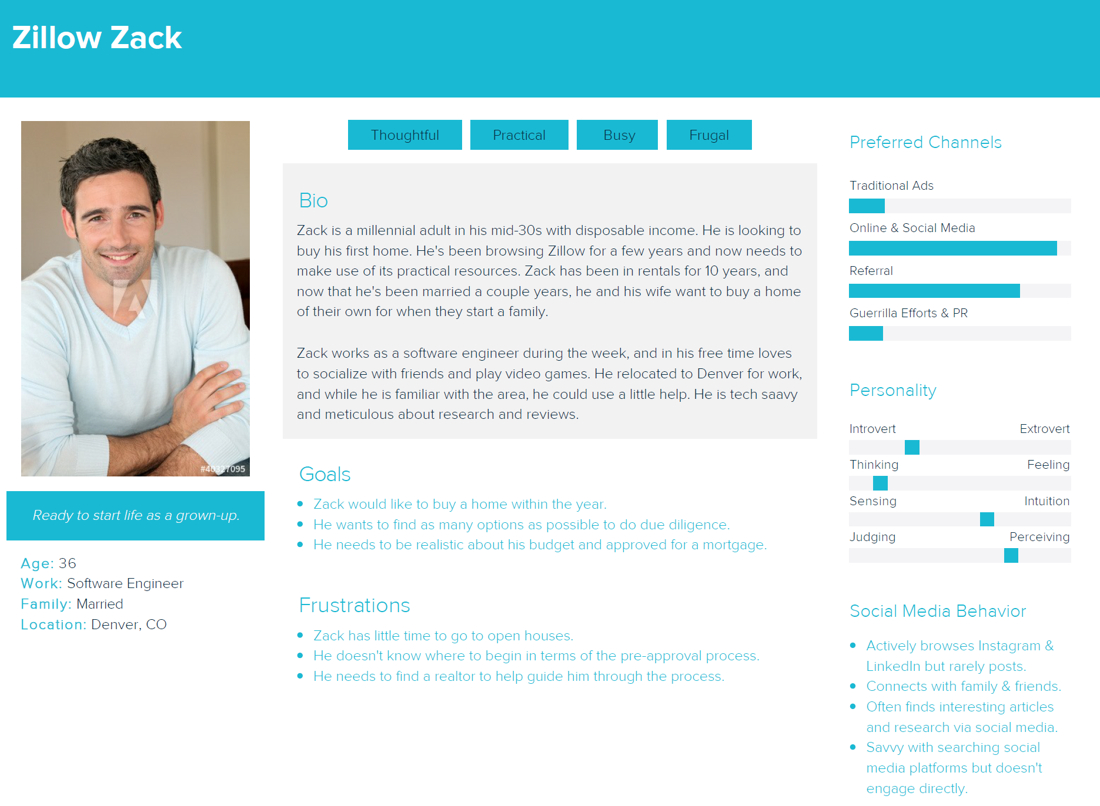

Slide 7
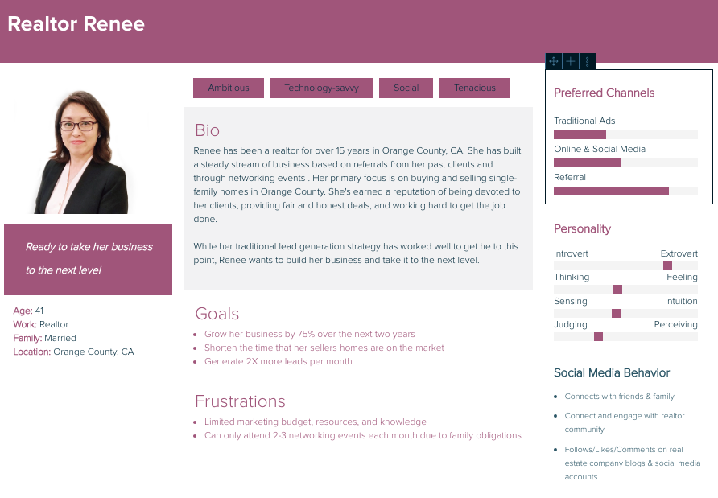

Slide 8
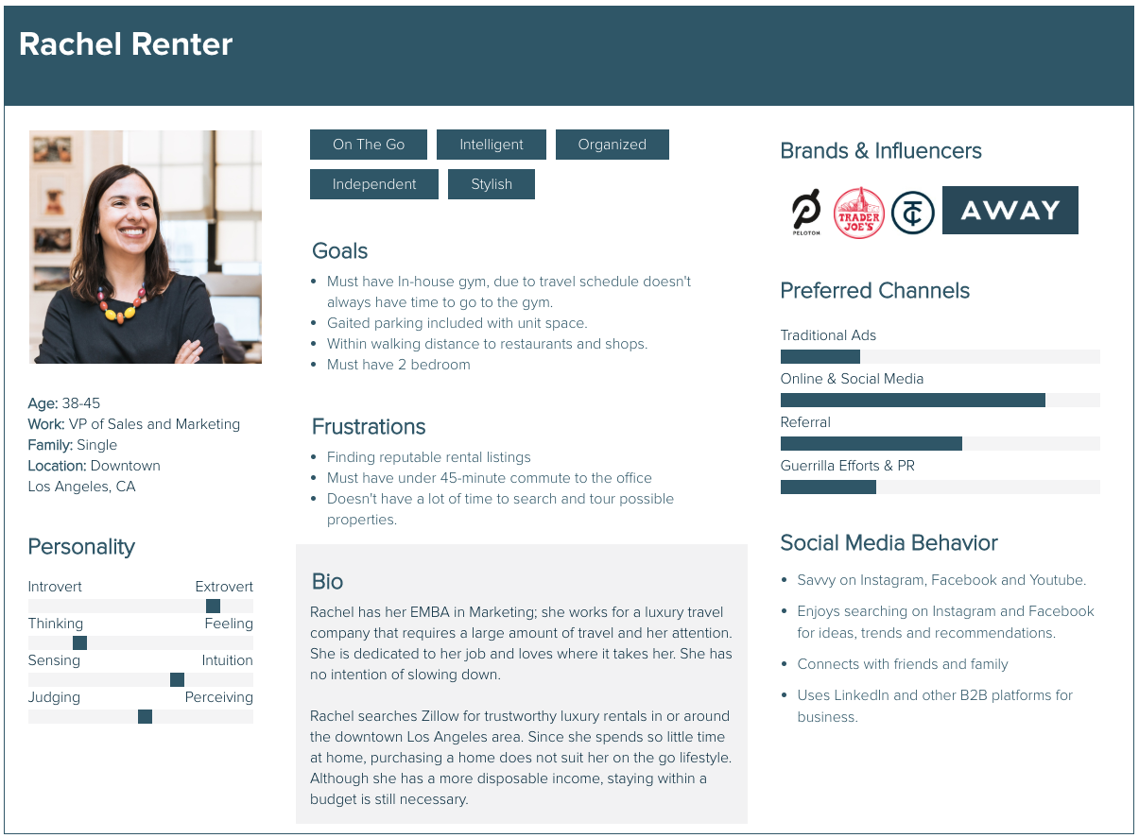

Slide 9
Digital Presence Overview
Zillow.com: The primary method where people buy, sell, and look for homes. Most familiar medium to audiences.
Social Media:
Twitter: 364k followers; combination of retweeted content and content promoting existing blog and website.
YouTube: 67k subscribers: combination of short commercials and original video content
Instagram: 301k followers; images of houses/rooms and descriptions and design tips
Facebook: 2.3M ‘likes’; lack of original content used as a gateway to website

Slide 10
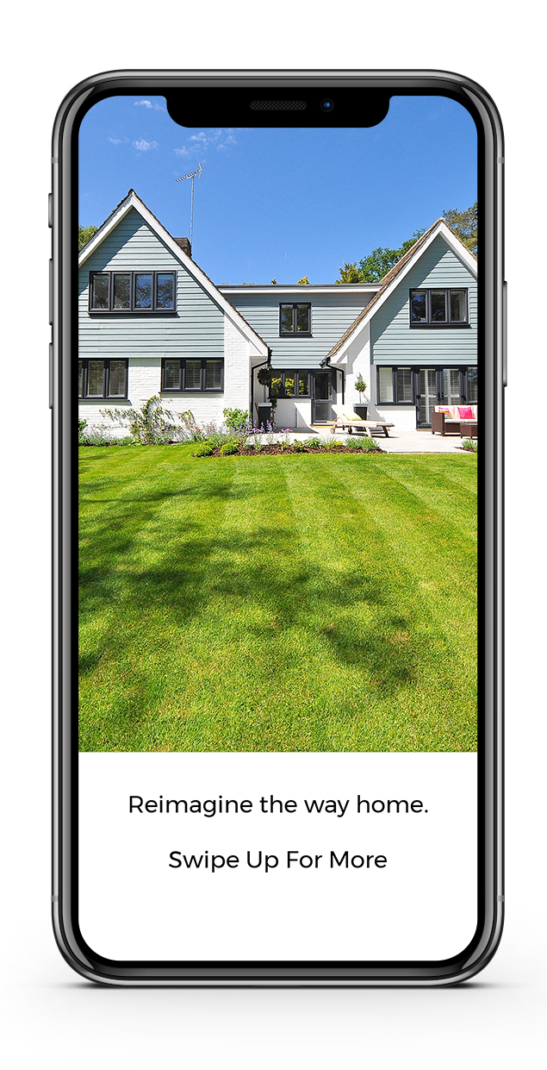
Sample Instagram Story
This ad will link to the Zillow home page when swiped. The home featured in the ad will be linked in a section labeled Social Media.

Slide 11
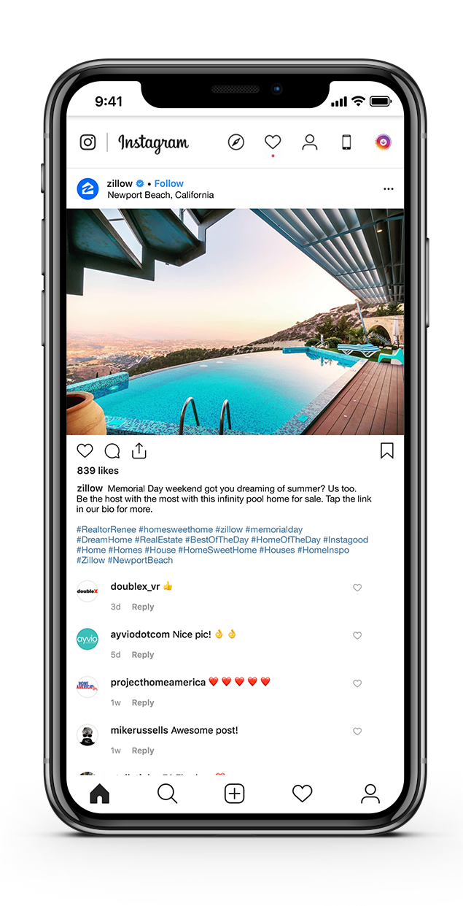
Sample Instagram Post
Memorial Day weekend got you dreaming of summer? Us too. Be the host with the most with this infinity pool home for sale. Tap the link in our bio for more.
#RealtorRenee #HomeSweetHome #MemorialDay #DreamHome #RealEstate #BestOfTheDay #HomeOfTheDay #Instagood #Home #Homes #House #HomeSweetHome #Houses #HomeInspo #Zillow #NewportBeach

Slide 12
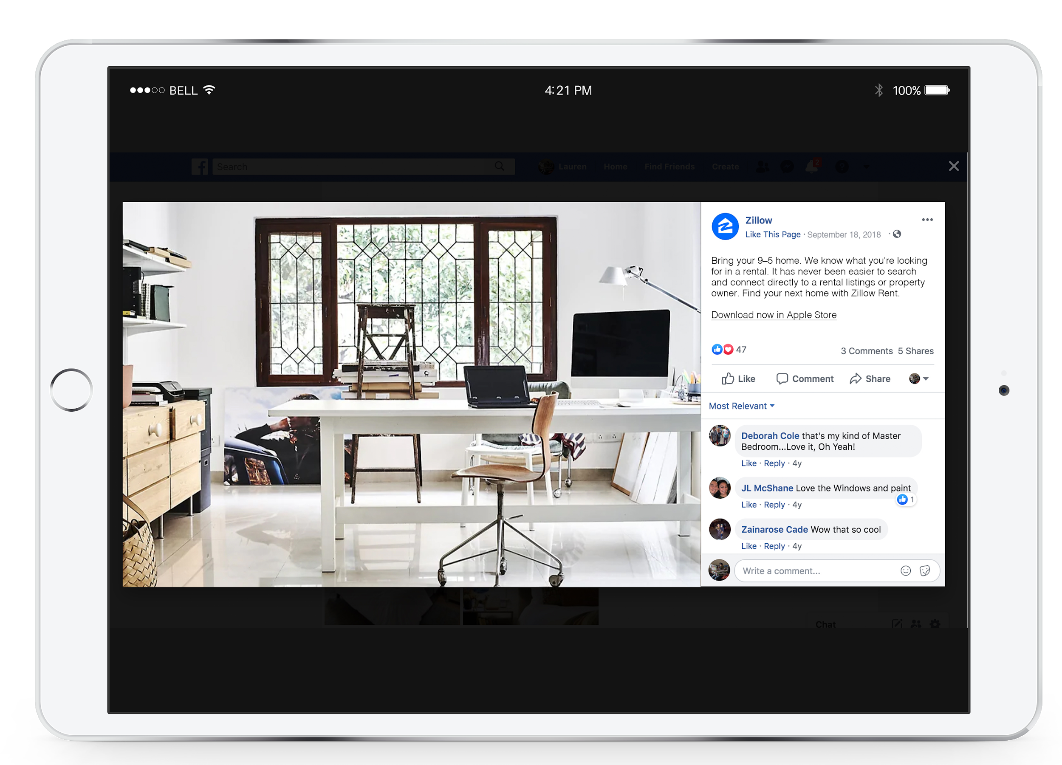
Sample Facebook Post
Bring your 9–5 home. We know what you're looking for in a rental. It has never been easier to search and connect directly to a rental listings or property owner.
Find your next home with Zillow Rent.
Notes:
Smart Upgrades
Renters prefer anything that makes life easier through technology. Property managers and renters alike can benefit from making upgrades in these areas
Mail Solutions
More than a quarter of renters said they receive at least one package per month, and 27 percent say they’ve had problems with receiving mail. Residents prefer to rent somewhere that offers package lockers that stay accessible around the clock.
Parking Lot Preferences
Sixty percent said they would pay more every month for a reserved parking spot.
Premium Amenities and Upgrades
Set your facility apart from the rest with amenity options renters can’t find anywhere else:
Corian, granite or quartz countertops
Large closets
A track or walking trail
USB charger duplex receptacles
State-of-the-art fitness center

Slide 13
Competitive Social Media Analysis
Facebook
~459k page likes
3-5 posts per month
Posts promote and drive traffic to existing webpage content
Minimal engagement with posts (likes, shares, comments)
Does not engage an/or respond to people’s comments
Twitter
~191K followers
3-5 posts per week
Posts promote and drive traffic to website, reference national publication content, and share user generated content
Fair amount of likes/shares
High engagement with fans (retweets/shares)
LinkedIn
~24K followers
Infrequent posts; 1-2 per month
Posts promote Trulia’s initiatives and successes in the workplace
Low engagement with posts

Slide 14
Competitive Social Media Analysis
Facebook
~12k page likes
Frequent posts; average of 1-2 per day
Posts promote and drive traffic to existing webpage content
Minimal engagement with posts (likes, shares, comments)
Interaction with followers / commenters is non existent
Twitter
~4k followers
Frequent posts; 5+ posts per month
Same content that is shared on Facebook accounts; use of common hashtags
Low engagement with posts (likes, shares, comments)
Minimal interaction with followers/audience
LinkedIn
~5kK followers
Frequent posts; 5+ posts per month
Same content shared on Facebook & Twitter
Low engagement with posts (likes, shares, comments)
Minimal interaction with followers/audience

Slide 15
Search Engine Marketing – Zillow.com
Goal:
To increase visibility of Zillow.com and Zillow’s Premier Agent program on search engines by using both paid and organic means.
Tactics:
PPC campaign through Google AdWords
Blog, copy, and video content with specific CTA
Organic SEO including website and keyword optimization
Locally targeted advertising

Slide 16
PPC Campaign Goals & Objectives
Campaign: Premier Agent PPC Campaign
Target Audience: Real estate agents looking to build their business and generate more leads
Time period: September – December (off season for home buying)
Goal:
Increase awareness of the Zillow Premier Agent program to real estate agents in the United States by providing a landing page with information, blog and video content, and testimonials about the Zillow Premier Agent Program
Objectives:
Achieve 1.5% CTR
Convert 10% of visitors into leads
Increase ranking on SERP
Increase quality of traffic and time spent on site

Slide 17
PPC Ad Campaign

Slide 18
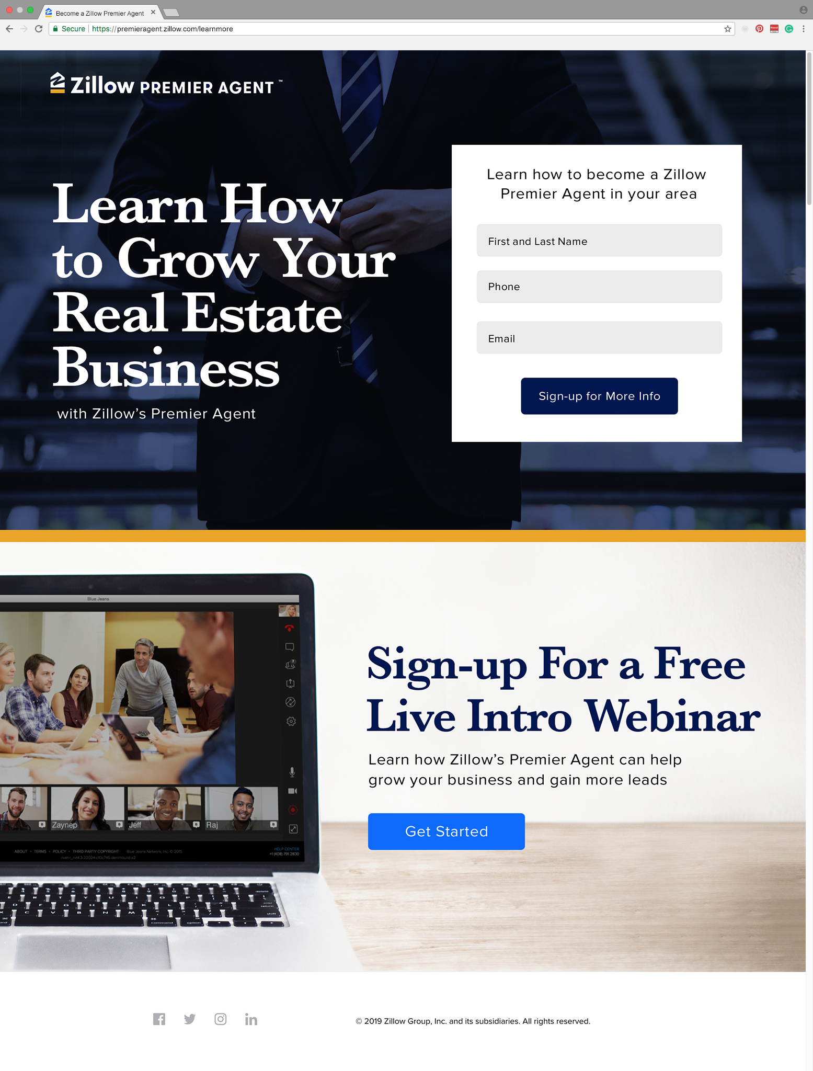

Slide 19
Keyword Phrases
PPC Campaign Specific:
Real estate marketing
Real estate advertising
Realtor marketing
Realtor advertising
Grow real estate business
Real estate business leads
Home buying advertising
Home selling advertising
Zillow Keyword Phrases:
Real Estate
Realtor
Homes for sale
Houses for sale
Homes for sale near me
MLS
Real estate agent
Apartments for rent
Homes for rent
Condos for sale
Condos for rent
Condos near me
Agents near me
Premier Agent
Zillow
MLS listing
Family home
Foreclosure
For sale
Real estate license
Buying a house
Real estate school
Local real estate agents
Best real estate agents
Real estate help
Where can I find a real estate agent?
When is the best time to buy a house?
How do I get started as a real estate agent?
How do I market myself as a real estate agent?

Slide 20
Campaign Keyword Phrases
Premier Agent
Real estate marketing
Real estate advertising
Realtor marketing
Realtor advertising
Grow real estate business
Real estate business leads
Home buying advertising
Home selling advertising
Advertising on Zillow

Slide 21
Conversion Path
Sign up for more information
Drip
Keyword
Search
PPC Ad
Landing Page
Convert
Sign up for webinar
Drip
Notes:
Real Estate agent uses campaign keywords to search for keywords with the primary objective of learning how to grow their real estate business and to generate their own leads
Zillow Premier Agent PPC ad appears in search results; real estate agent clicks ad
Clicking the ad takes agents to a land page that introduces the Premier Agent program, explains the features of the program (text & video), highlights testimonials (text & video) showing the success of the program.
Real Estate agent is presented with the primary CTA to sign up for more information; real estate agent is entered into drip campaign to receive weekly e-mails to promote the program, ways to brand and grow their business, and special offer to sign up for the new program
If the real estate agent is not ready to receive more information about the program, the secondary CTA is presented to sign up for a webinar about growing a real estate business
Hour long webinar that provides a step-by-step approach to grow a real estate business online told from the point of view of other real estate agents who have successfully used digital tools to grow their business
Purpose is to provide value to real estate agents and to address their needs as business owners with limited time and budgets
After the webinar, real estate agents are entered into a drip campaign that continues to provide more information about building a business, testimonials, an promoting the Zillow Premier Agent program as the ideal solution

Slide 22
Zillow Home Finder App
Target Audience:
The Zillow Home Finder App will primarily serve as a functional and convenient on-the-go resource for adults shopping for a home. The app will also serve as a tool for agents to manage listings and access training programs and tool kits.
Value Proposition:
The app will feature a searchable catalog of listings across the country, as well as information on neighborhoods and real estate agents. A consumer may drive by a for-sale or for-rent sign and want more info, so they pull up the app and search for listings "near me“ to get information on price, floor plan, and open houses. We will also feature QR codes on the for rent or sales signs, and use the app to the code and be taken to the brokers landing page. The app will also feature resources for agents to help manage listings and aid in their business growth.
Notes:
Real Estate agent uses campaign keywords to search for keywords with the primary objective of learning how to grow their real estate business and to generate their own leads
Zillow Premier Agent PPC ad appears in search results; real estate agent clicks ad
Clicking the ad takes agents to a land page that introduces the Premier Agent program, explains the features of the program (text & video), highlights testimonials (text & video) showing the success of the program.
Real Estate agent is presented with the primary CTA to sign up for more information; real estate agent is entered into drip campaign to receive weekly e-mails to promote the program, ways to brand and grow their business, and special offer to sign up for the new program
If the real estate agent is not ready to receive more information about the program, the secondary CTA is presented to sign up for a webinar about growing a real estate business
Hour long webinar that provides a step-by-step approach to grow a real estate business online told from the point of view of other real estate agents who have successfully used digital tools to grow their business
Purpose is to provide value to real estate agents and to address their needs as business owners with limited time and budgets
After the webinar, real estate agents are entered into a drip campaign that continues to provide more information about building a business, testimonials, an promoting the Zillow Premier Agent program as the ideal solution

Slide 23
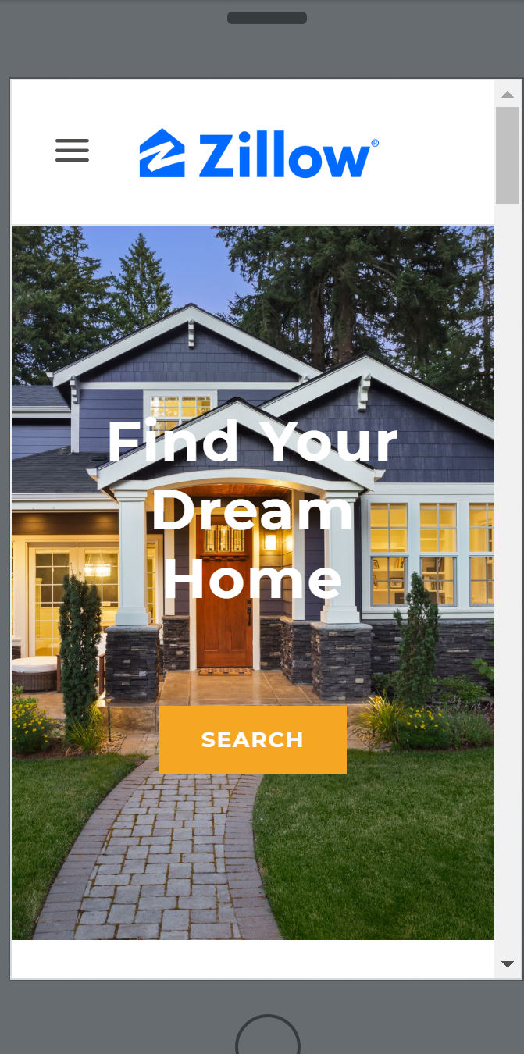
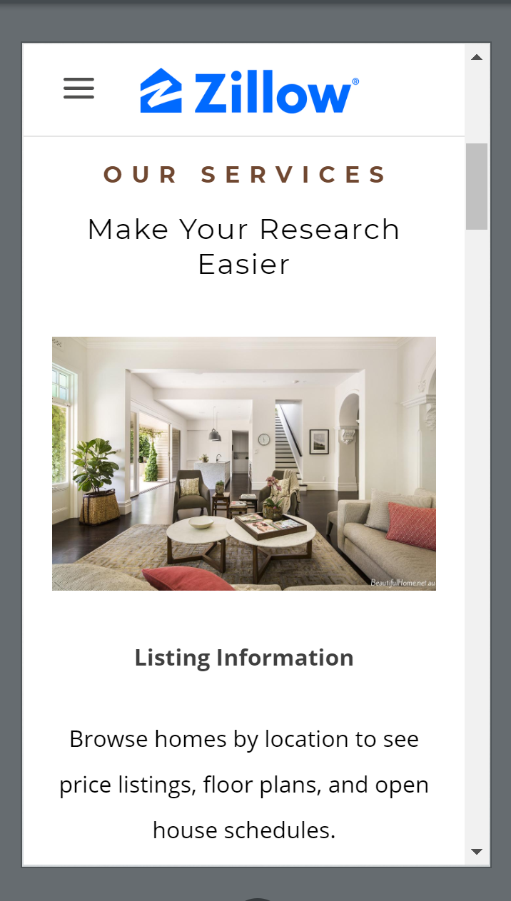
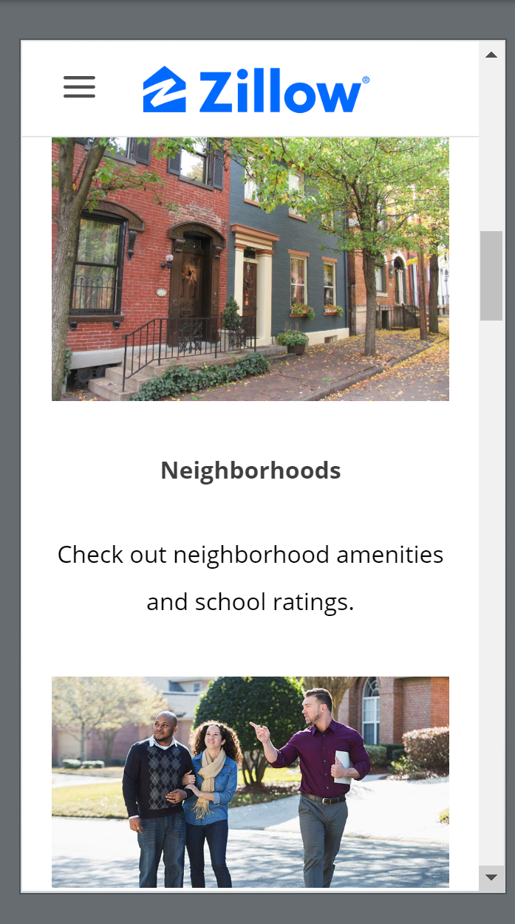
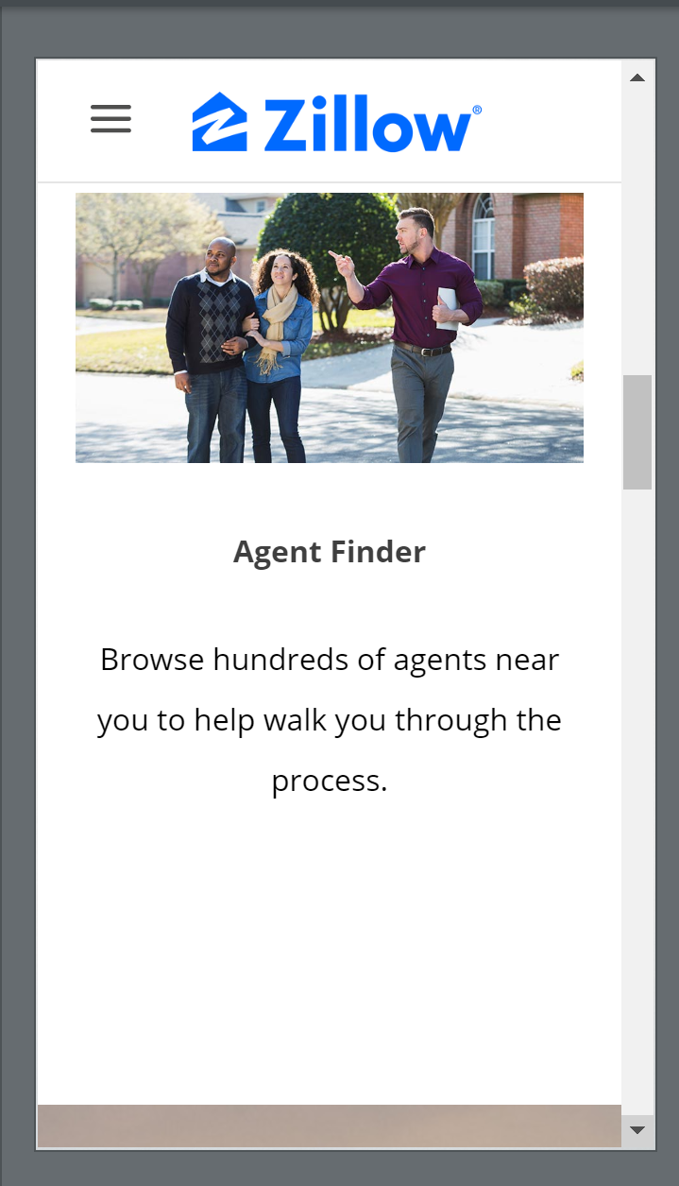
Zillow Home Finder
Notes:
Real Estate agent uses campaign keywords to search for keywords with the primary objective of learning how to grow their real estate business and to generate their own leads
Zillow Premier Agent PPC ad appears in search results; real estate agent clicks ad
Clicking the ad takes agents to a land page that introduces the Premier Agent program, explains the features of the program (text & video), highlights testimonials (text & video) showing the success of the program.
Real Estate agent is presented with the primary CTA to sign up for more information; real estate agent is entered into drip campaign to receive weekly e-mails to promote the program, ways to brand and grow their business, and special offer to sign up for the new program
If the real estate agent is not ready to receive more information about the program, the secondary CTA is presented to sign up for a webinar about growing a real estate business
Hour long webinar that provides a step-by-step approach to grow a real estate business online told from the point of view of other real estate agents who have successfully used digital tools to grow their business
Purpose is to provide value to real estate agents and to address their needs as business owners with limited time and budgets
After the webinar, real estate agents are entered into a drip campaign that continues to provide more information about building a business, testimonials, an promoting the Zillow Premier Agent program as the ideal solution

Slide 24
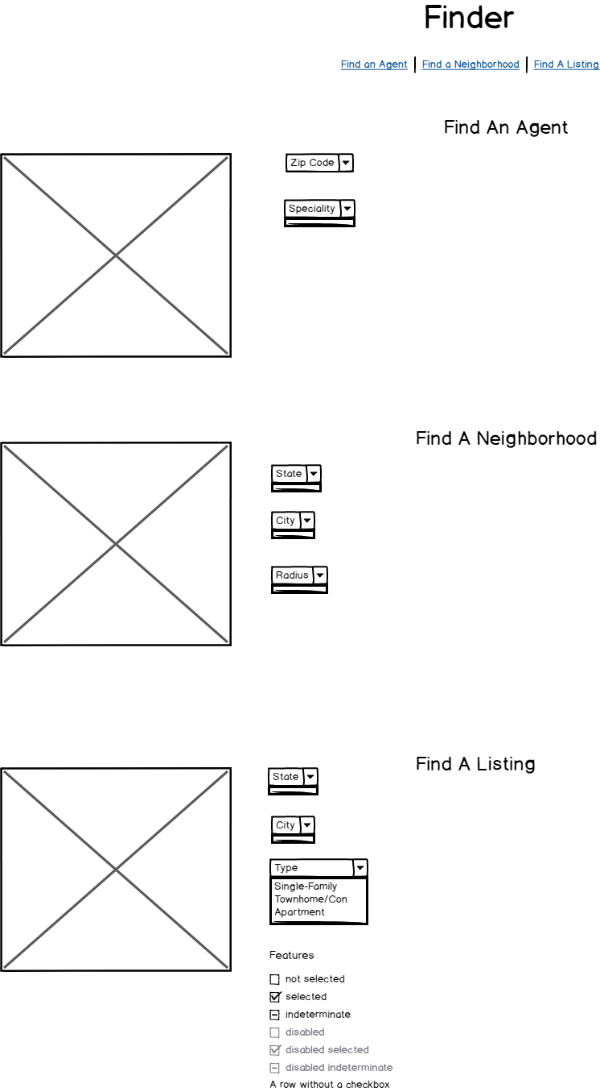
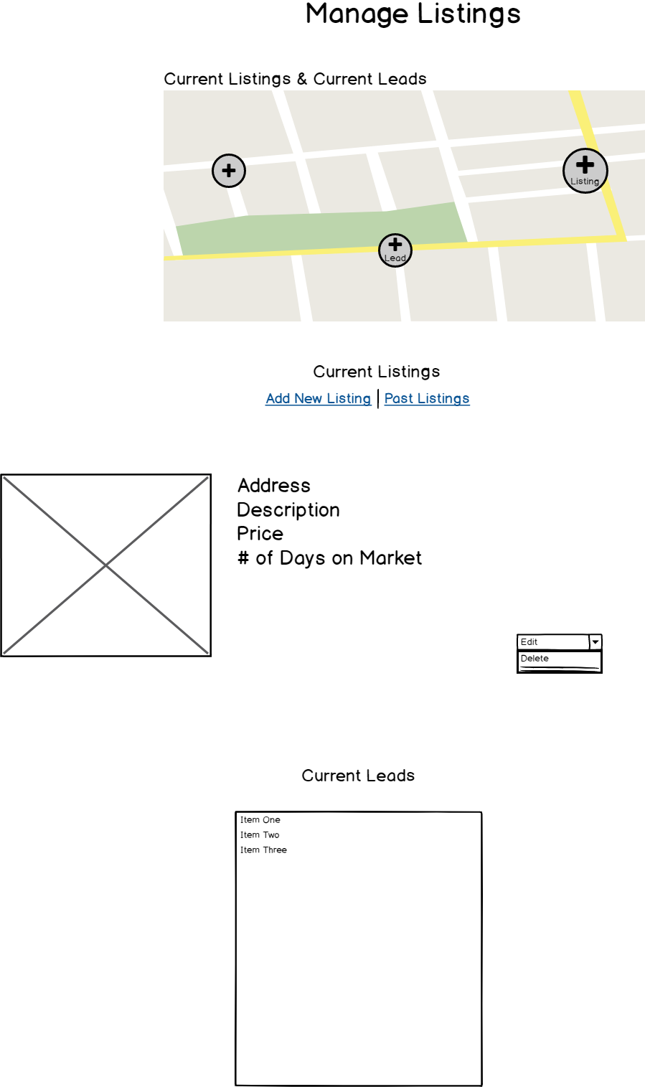
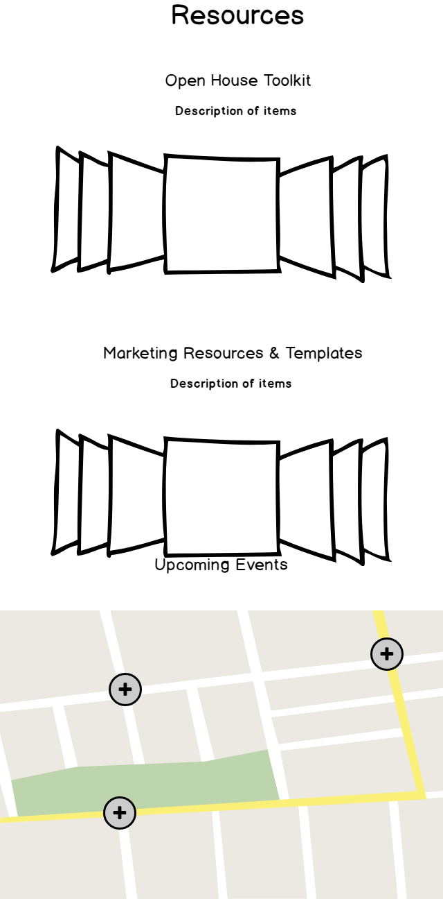
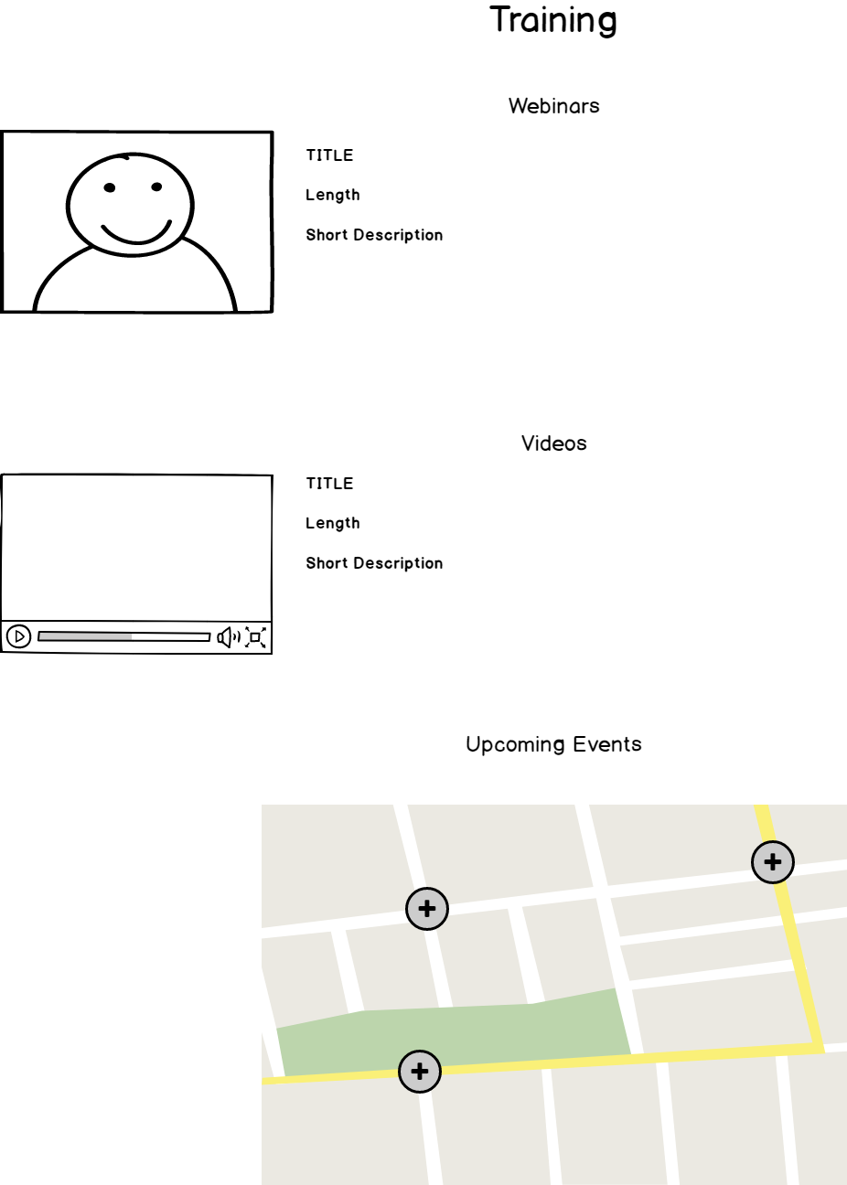
Wireframe of Zillow Home Finder
Notes:
Real Estate agent uses campaign keywords to search for keywords with the primary objective of learning how to grow their real estate business and to generate their own leads
Zillow Premier Agent PPC ad appears in search results; real estate agent clicks ad
Clicking the ad takes agents to a land page that introduces the Premier Agent program, explains the features of the program (text & video), highlights testimonials (text & video) showing the success of the program.
Real Estate agent is presented with the primary CTA to sign up for more information; real estate agent is entered into drip campaign to receive weekly e-mails to promote the program, ways to brand and grow their business, and special offer to sign up for the new program
If the real estate agent is not ready to receive more information about the program, the secondary CTA is presented to sign up for a webinar about growing a real estate business
Hour long webinar that provides a step-by-step approach to grow a real estate business online told from the point of view of other real estate agents who have successfully used digital tools to grow their business
Purpose is to provide value to real estate agents and to address their needs as business owners with limited time and budgets
After the webinar, real estate agents are entered into a drip campaign that continues to provide more information about building a business, testimonials, an promoting the Zillow Premier Agent program as the ideal solution

Slide 25
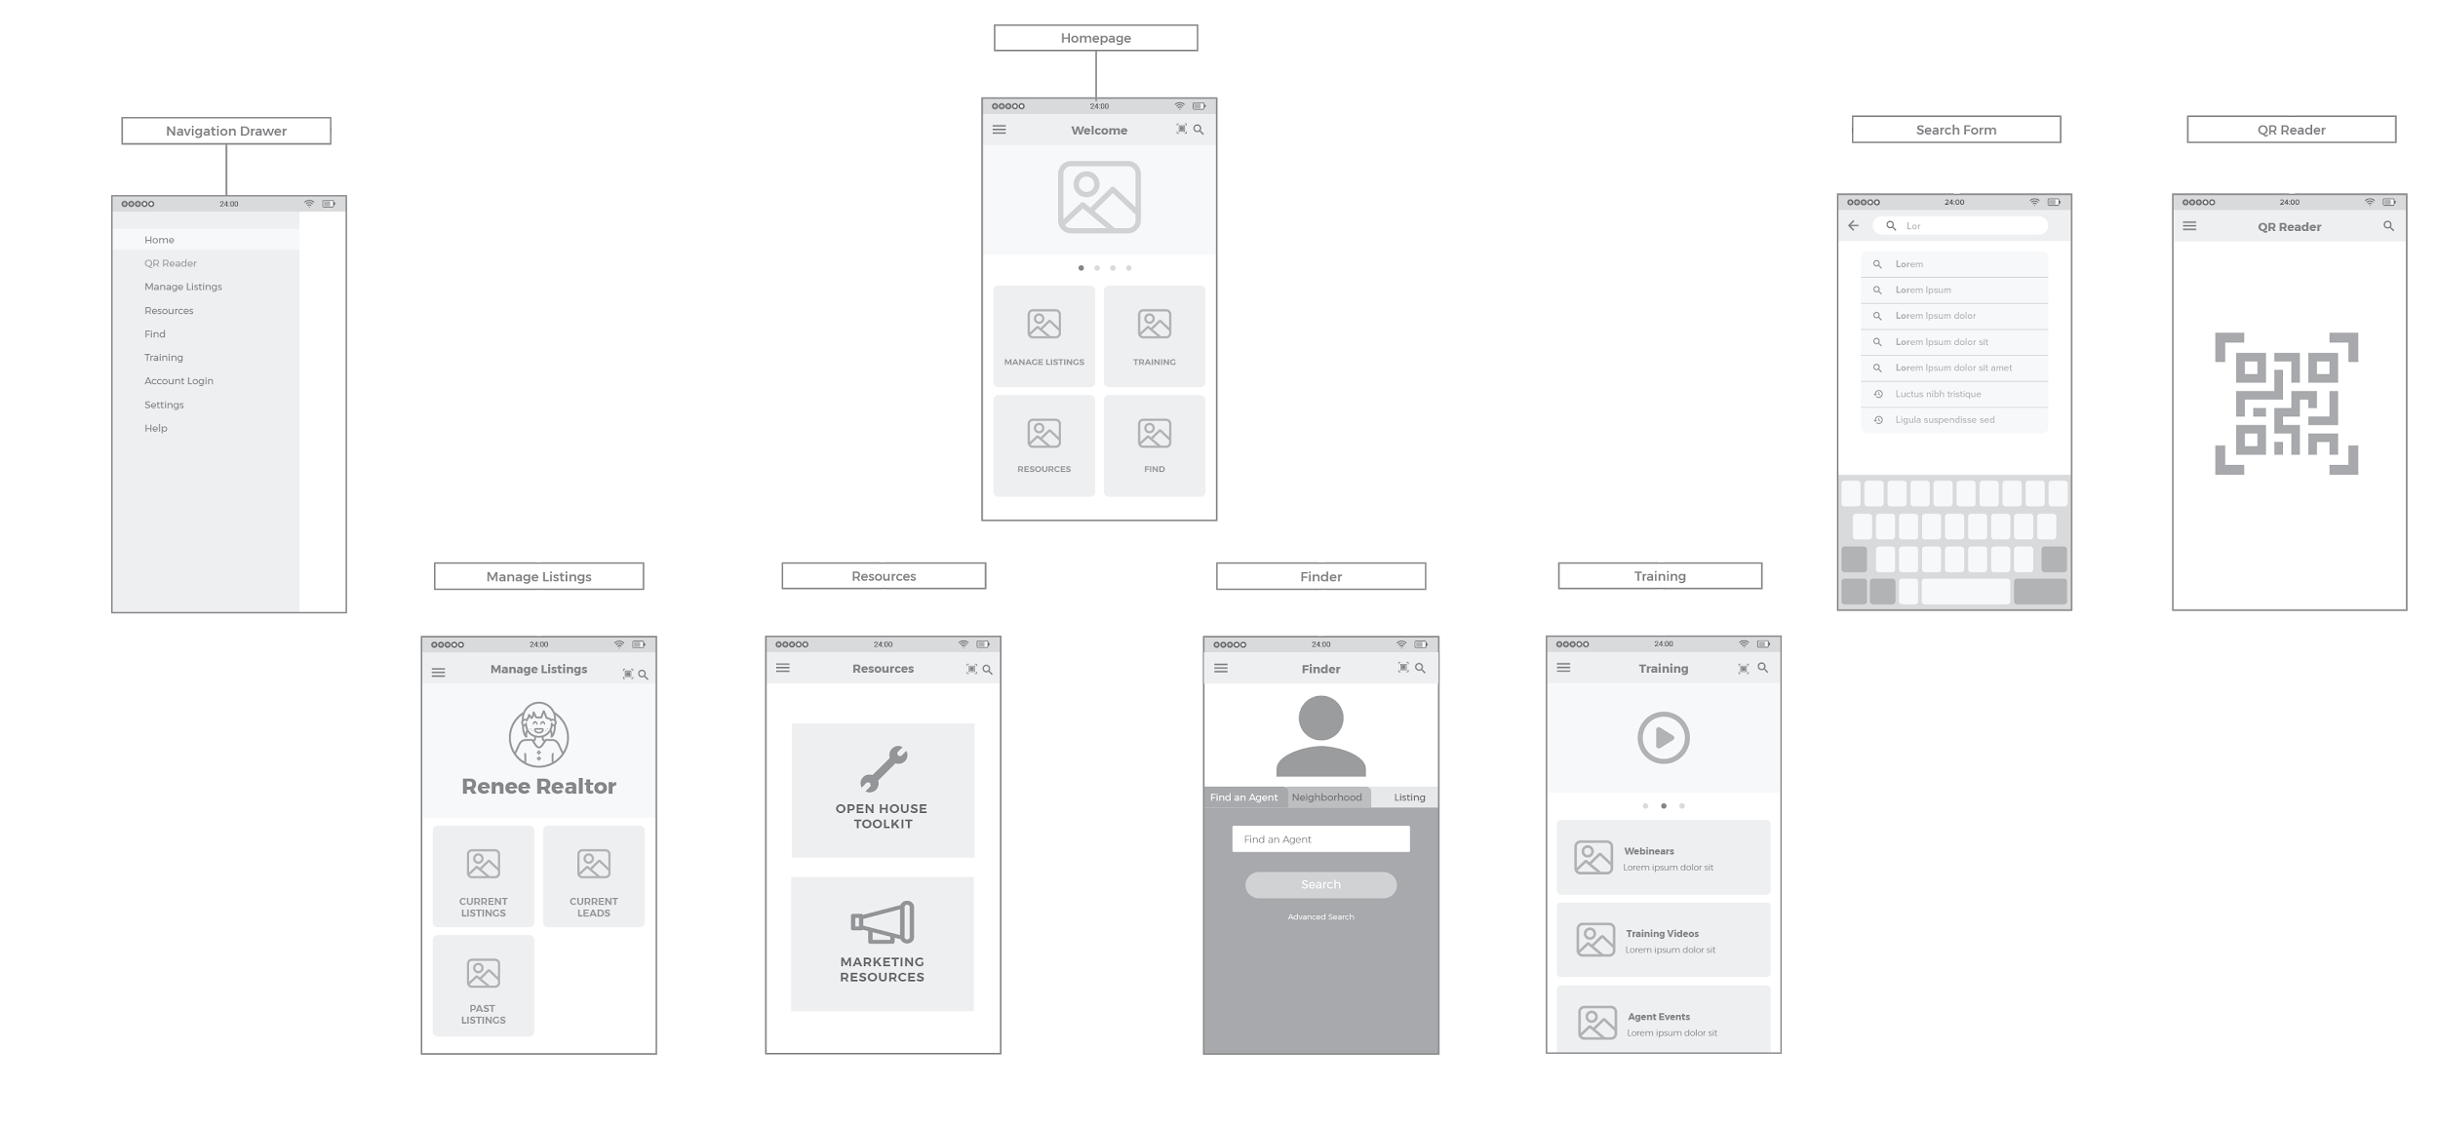
Sitemap

Slide 26
Analytics, Testing, and Optimization
Optimize primary website and landing pages to ensure CTAs are clear, concise, and placed correctly on website.
Measure conversion rates for PPC ads (how many real estate agents join program and how many real estate agents request more information)
Determine success of drip campaign by measuring CTR and conversion rates. Determine how many emails it takes to convert/drop off. Adjust where necessary to improve time to conversion.
Conduct A/B testing to improve open-rates and adjust where necessary
Continuously refresh and monitor Google Adwords and adjust based on performance/key trends in real estate space

Slide 27
Conclusion
In summary, this digital marketing plan aims to convert more prospects into true leads, increase click-through rate, increase SERP ranking, and improve both the quantity and quality of traffic to Zillow.com. By following the recommended plan of action, we are addressing multiple aspects of Zillow’s business. In addition to organic SEO, the PPC ad campaign will target real estate agents for the Premier Agent program. Increasing the social media presence will boost engagement from casual and active home seekers, and mobile marketing with the Home Finder app connects the two together.

